Slide 1

B.Tech Project Evaluation-2,VIIIth Sem
COVID-19 Outbreak Prediction using machine learning​. ​
Presented by
Vaishali Chhonkar 2019007712
Disha Bansal 2019007712
Khallilluah Ahmad 2018002354
Sayed Fayaz Sadat 2018011644 Under the Supervision of Dr.Anil Kumar Sagar
Sharda University Greater Noida
DEPARTMENT OF COMPUTER SCIENCE & ENGINEERING​
SCHOOL OF ENGINEERING AND TECHNOLOGY ​
MAY 2022​

Slide 2
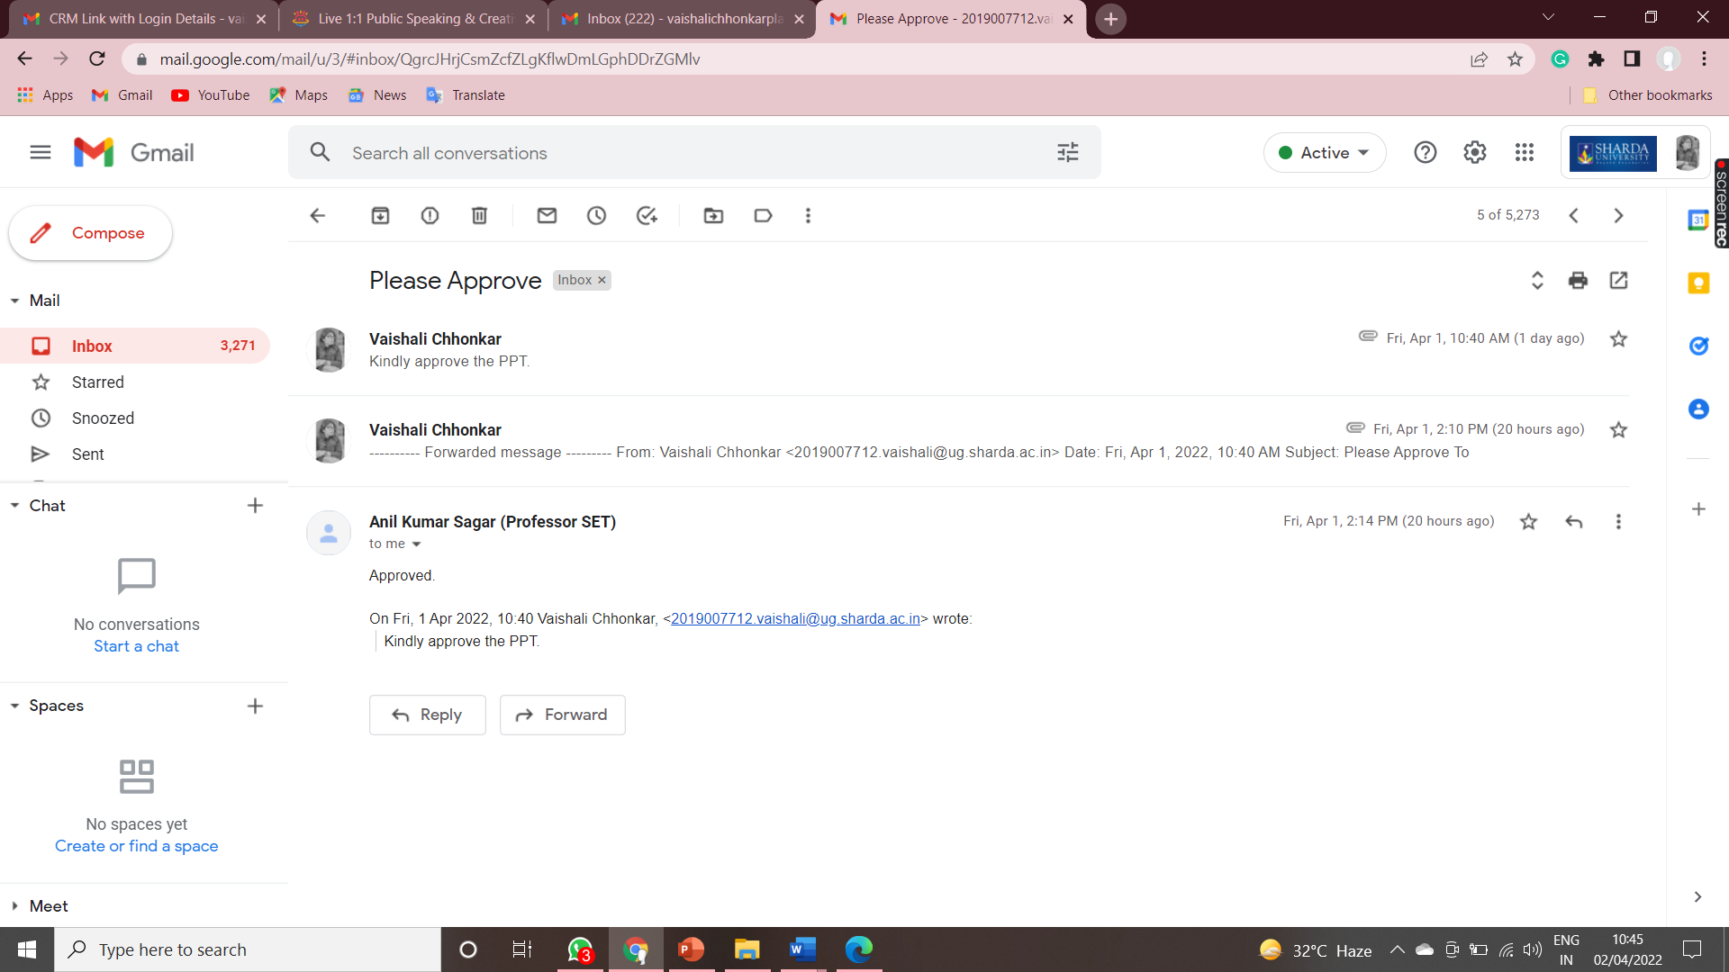
APPROVAL FROM THE GUIDE FOR EVALUTION.

Slide 3
CONTENTS
INTRODUCTION AND ORIGIN OF RESEARCH WORK.
MOTIVATION.
IMPROVEMENT AND WORK DONE IN LAST SEMESTER.
PROOF OF PAPER ACCEPTED OR COMMUNICATED HACKATHON OR PATENT.
SOFTWARE REQUIREMENTS.
HARDWARE REQUIREMENTS.
WORKFLOW DESCRIPTION.
USED ALGORITHMS.
WORK DONE IN 7TH SEMESTER.
RESULT.
CONCLUSION.
REFERENCES.

Slide 4
WORKLOAD DISTRIBUTION OF TEAM.
Implimentation Vaishali,Disha,Fayaz,Ahmad
Documentation Vaishali,Disha
Research Paper Vaishali, Disha

Slide 5
INTRODUCTION AND ORIGIN OF RESEARCH WORK. ​ ​
Covid is the greatest global health crisis faced by the planet. Countries try their best to treat and test their people. And after the lockdown, many countries faced economical financial unemployment, and political issues in countries. thanks to lockdown many exams, job scheme which was visiting be proposed is been cancelled and postponed because of this covid lockdown social gatherings places are closed. Covid outbreak prediction Analysis helps to predict this pandemic recognize the spread cycle which might help to require the important measure to decrease the spread rate and that we can use economic resources efficiently to areas of greatest need by public health officials WHO. The proposed model is named covid outbreak prediction using machine learning we are using algorithms like Linear Regression, Support Vector Machine Classifier SVM. This aim is to predict the out Break before it's observed that the most effective performance is of the XG boost classifier. However, accuracy may be improved using hyperparameter turning.

Slide 6
MOTIVATION.
As we will have more than one Datasets we will be working closely with each dataset and making it ready for applying machine learning techniques. After data pre-processing, we will choose the best algorithms from Logistic Regression, Linear regression, Support Vector Machine, Random Forest, Gradient Boosting, Histogram Gradient Boosting, XG boost, Light GBM classifier, etc.
In this project, we are predicting covid19 outbreak using machine learning and we are using algorithms like support vector machine (SVM) and linear regression (LR)which is a type of regression these algorithms come under supervised learning. The main objective of this project is to predict the outbreak in advance it is observed that the best performance is of regression. However, accuracy can be improved using more accurate data analysis.

Slide 7
IMPROVEMENT AND WORK DONE IN LAST SEMESTER.
After last evaluation which was held on 9-february-2022, We worked on research paper and the discuss points in the meeting.The panel members asked us to work on research paper in last meeting.
We worked on research paper and completed it and patent it on (IJSER) our paper got accepted for publishing.

Slide 8
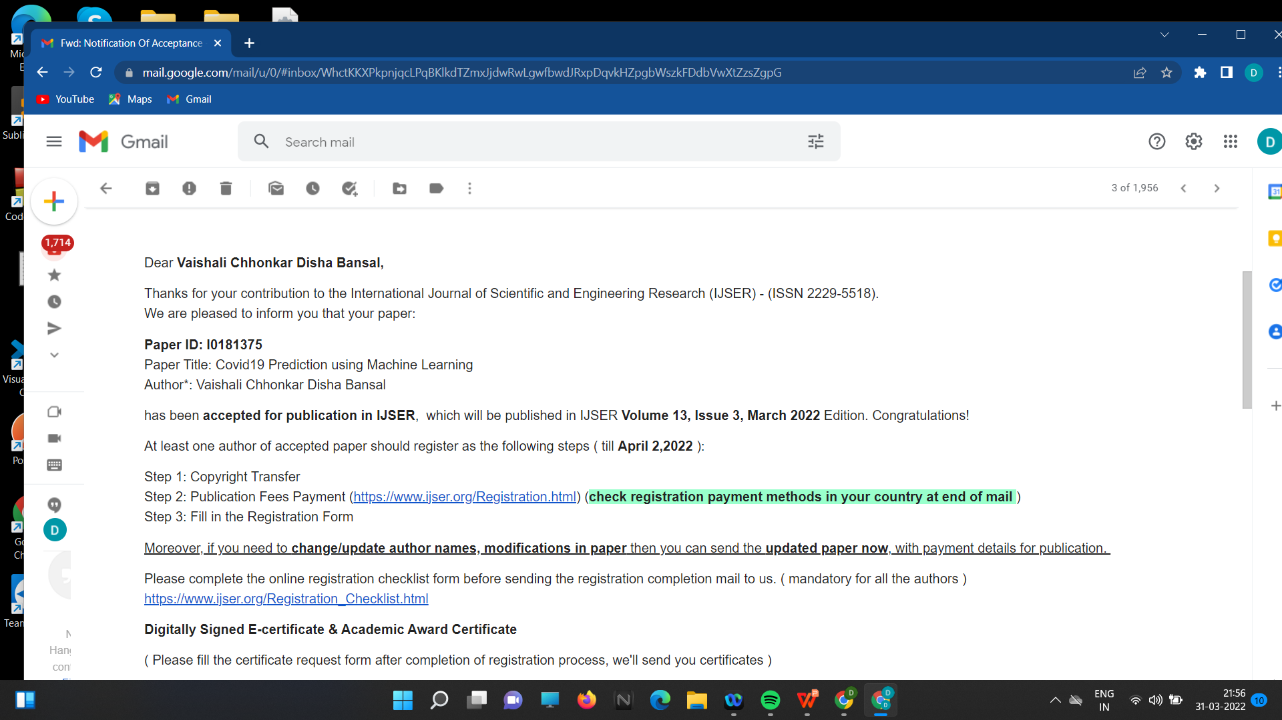
PROOF OF PAPER ACCEPTED OR COMMUNICATED HACKATHON OR PATENT.

Slide 9
LITERATURE SURVEY
Aanalysing Rehabilitation Through Reading Theory: The Covid-19 Case Predicting the recovery time from an outbreak of infectious diseases was done in this study. The error learning method is used here, by setting objection measures such as treatment, segregation, social isolation, etc especially to harmonize control of the virus spreads by reducing the levels of infection if this is effective, the rate of infection, in the background to reach the top, down to follow what is Universal Recovery Curve. The danger of infectious diseases is rare when the rate of infection is slow, which is called 'loosening of the curve' '. When the rate increases, then it should decrease because of effective fighting measures.
Covid-19 Future Forecasts using machine-readable monitoring models Machine learning (ML) contributes to the results of working to improve decision-making the future course of action-based prediction has proved its worth expectations. Predicting the number of future patients affected by COVID-19 is made with ML models. Typical prediction models like total reduction and selection operator (LASSO), support vector support (SVM), linear regression (LR), and large display smoothing (ES) have been used to predict COVID-19 threats. ES doing very well in the current field of prediction comes from research results that prove that given the type and size of the database. LR and LASSO are also doing well in predicting to some extent predicting the death rate and confirming cases.

Slide 10
Exploring strategies to respond to the epidemic in Delhi using Realistic Social Networks. The influenza epidemic in the National Capital Territory of India (NCT-I, including New Delhi and surrounding areas), analyze the indicated line content strategies are developed. A personal network of personal communication. CT-I is an important contribution of our work to integration by using various open-source data and commercial data. What a flu-like illness (ILI) by calculated using a natural model will spread across the NCT-I network. The active and non-pharmaceutical content strategies are analyzed to control an outbreak of plague. In practice, such a network with the powerful epidemiological simulation platform Epinasty, a study of various things interventions to prevent the spread of disease in the city are being developed.
Detection of covid 19 is investing rapidly in last year in this paper the first part is to detect covid19 based on deep learning using CT scan and chest X-ray image. In the second part to estimate the number of covid19 confirmation recoveries and death. Covid 19 is a global pangamic which is spreading rapidly. It is very hard to detect because there is no symptoms. Here AI is used to examine a person for covid19 main advantage of AI t can be implemented in a trained model to classify unseen images in this paper to detect whether a patient is for covid 19 using their chest x-ray image AI also used for existing evidence here in this paper we focused on two concepts the first concept is to study related h diagnose of covid19 and second I sto involve study related to predicting a number of people who will be infected in coming days.

Slide 11
Data Mining and Analysis of Data Research Sciences Data Covid-19 Death, Prevention, and Drug Development - In the First Covid-19 Epidemic.Covid-19 death details, immunizations, and vaccines are available by data mining of scientific literature records from the Core Science Web Collection, used. The analysis compares the records throughout the Covid-19 study topics are included and individual records are analysed individually. Including Web Science, a tool for digging data records data is analysed flexibly mathematical methods. From the historical analysis of scientific records on viruses, epidemic of disease and death, it is found that Chinese universities were not which leads to these topics historically. We have identified a few collections, which contain indications for exercise, inflammation, smoking, obesity and many more.
Imitation of H1N1 Influenza Virus Using GIS in South Korea the spread of disease worldwide continues to accelerate and build up transport technology. In this paper based on GIS integration testing between travel and infection, statistical analysis of highway transport and domestic flight. By performing SEIR measurements using logic, regional infection can be predicted when an outbreak occurred to make rapid responses to the threat of disease. Through to imitate, it can be found that densely populated regions also have-the biggest infection. In conclusion, regions with greater entry than exits have many people with the virus and infection in other areas with poor transportation low in comparison.

Slide 12
Covid 19 first was recognized in Wuhan, China, and declared a pandemic by the World Health Organization (WHO) on 11 March 2020. Here have developed a cloud-based machine learning short-term forecasting of the progress of pandemic in which several regression-based machine learning models were applied to infected case data to estimate the number of COVID-19-infected people. In this approach, we can accurately forecast the number of infected cases daily by training prior 25 days sample data recorded on which Machine Learning can be utilized to extract useful information from extensive datasets and build intelligent prediction models for healthcare, a brief description of the datasets employed in this paper. This section also explains and discusses the features of the machine learning models and describes the procedures used in the current study.
In this paper we use a machine learning algorithm in order to diagnose covid 19 infected patients more effectively. This method is evaluated using different experimental analysis metrics such as accuracy, precision, recall, and f1-score, Machine learning algorithms work on trial error-based methodologies.

Slide 13
SOFTWARE REQUIEMENT
Anaconda Individual Edition.
Python IDE (JUPYTER Notebook)
ML and DL libraries

Slide 14
HARDWARE REQUIREMENT
Pc/Laptop
Processor: Minimum 1 GHz; Recommended 2GHz or more.
Ethernet connection (LAN) OR a wireless adapter (Wi-Fi)
Hard Drive: Minimum 32 GB; Recommended 64 GB or more.
Memory (RAM): Minimum 1e GB; Recommended 4 GB or above

Slide 15
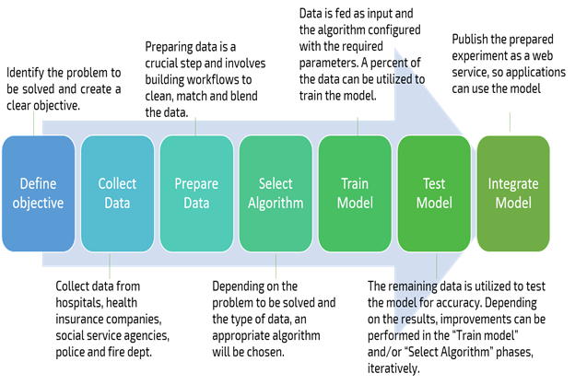
WORKFLOW DESCRIPTION

Slide 16
USED ALGORITHMS. Support vector machine. Linear Regression.
Machine learning has three types of classifications:
1. Supervised classification
2. Unsupervised classification.
3. Reinforcement classification.
SVM comes in supervised classification.
A Support vector machine is a supervised machine learning model that uses a classification algorithm for two-group classification problems.it is used for classification and regression analysis. After giving an SVM model sets of labeled training data for each category they are able to categorize new text.
.

Slide 17

Regression analysis.
Regression analysis is a form of predictive modelling technique that investigates the relationships between a dependent and independent variable. We use regression analysis for determining the strength of Predictors, Forecasting an effect and trend forecasting.
Types of Regression analysis:
Linear regression.
Logistic regression.
Think of a straight equation line combining any two variables X and Y which can be declared algebraically as:

Slide 18
LINEAR REGRESSION
Linear regression is perhaps one of the most well-known and well-understood algorithms in statistics and machine learning. Linear regression is a linear model e.g. a model that assumes a linear relationship between the input variables (x) and the single output variable(y). More specifically that y can be calculated from a linear combination of the input are regression.
When there is a single input variable (x), the method is referred to as simple linear regression. When there are multiple input variables literature from statistics often refers to the method as multiple linear regression
Linear regression is perhaps one of the most well-known and well-understood algorithms in statistics and machine learning. Linear regression is a linear model, e.g., a model that assumes a linear relationship between the input variables (x) and the single output variable (y). More specifically, that y can be calculated from a linear combination of the input variables (x).
When there is a single input variable (x), the method is referred to as simple linear regression. When there are multiple input variables, literature from statistics often refers to the method as multiple line regression.

Slide 19
Work Done in 7th Semester.
During the 7th semester, we showed 70% completion of our project covid 19 prediction. Firstly we collected the datasets from the git hub, using python we read the dataset and perform some analysis preprocessing and visualization, and features extraction. Furthermore, we applied some statistical analysis to the data and made it ready for model building. We selected some algorithms such as Linear Regression and Support Vector Machine. In this semester we are going to train these different models and evaluate the performance of each algorithm.
Prepared the documentation as per the need.
Discuss with our Mentor about the project building and further requirements.

Slide 20
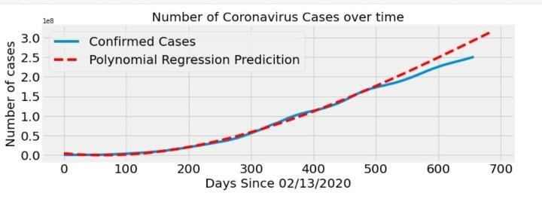
RESULT This graph represents the prediction rate of coronavirus confirmed cases in the world over time. This outcome has been analyzed with the live data that we have taken for the prediction. The blue line shows the confirmed rate using the data analysis and the red line shows the algorithm that we used linear regression prediction accuracy rate for the confirmed cases.

Slide 21
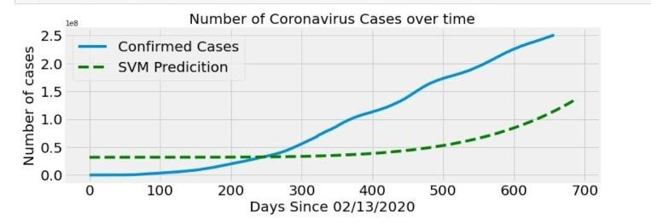
This graph represents the prediction rate of coronavirus confirmed cases in the world over time in comparison with the SVM. This outcome has been analysed with the data we have taken for the prediction. In this graph the blue line shows the best fit line of confirmed cases with the help of data taken and the green lines shows about the prediction rate of SVM.

Slide 22
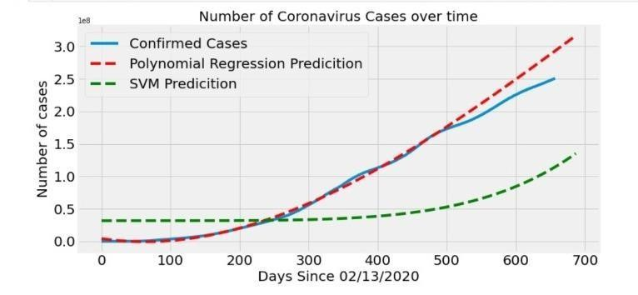
This project “covid19 outbreak prediction using machine learning is a prediction project. After the prediction and the final testing has been done using ML supervised algorithm which is linear regression and SVM. And after doing the testing with live data which we have taken from GitHub and then compared both the Algorithm with live data we found that the linear regression algorithm is best for prediction covid19 outbreak in this research.
.

Slide 23
CONCLUSION
The Coronavirus Disease (COVID-19) Outbreak in India and outside India was studied in this report. COVID-19's transmission in India and worldwide is influenced by a variety of variables, including religious gatherings, which can function as a super-spreader of the virus. Any future gatherings like this will be harmful to people's health. Lockdown has shown to be an excellent move in India, and it should be expanded much further. Many unknown criteria might lead to huge uncertainty in the projection; the prediction is meant to aid the government in making future decisions and dealing with the continuing coronavirus spread in India. As this study anticipated, greater attention should be paid to control measures such as increasing the testing rate, maintaining social distance, and avoiding needless gatherings. If all of these measures are taken into account, the severity of COVID-19 in India may eventually be reduced to a manageable level. The results of this study raise nurses' education, increasing their desire to deal with high-risk patient groups. The findings of this study will aid in the planning of healthcare resources and the development of effective prediction of the virus and more knowledge about it.

Slide 24
REFERENCES
[1] International Journal of Computer Information Systems and Industrial Management Applications. ISSN 21507988 Volume 12 (2020).
[2] MIR Labs, www.mirlabs.net/ijcisim/index.html Machine Learning and Deep Learning Covid-19 Project-Final Report Project: Spread Visualization and Prediction of the Novel Coronavirus Disease COVID-19(2019).
[3] Sahas Ramanan A., & Kumar, N. (2020). The network structure of COVID19 spread and the lacuna in India’s testing strategy. Available at SSRN3558548 from https://arxiv.org/ftp/arxiv/papers/2003/2003.09715 on 3rd April 2020.
[4] Machine learning-based prediction of COVID-19 diagnosis based on symptomsYazeed Zoabi(2020)
[5] Rajan Gupta, Saibal K. Pal and Gaurav Pandey. A Comprehensive Analysis of COVID19 Outbreak situation INDIA Access from WHO Coronavirus disease (COVID-19) Pandemic (2020).

Slide 25
[6] Janmajay Nayak, Vighnaraaj Naik, Paidi Dinesh,Kanithi Vakula, B. Kameswara Rao, Weiping Ding, Danilo Pelusi. Intelligent system for COVID-19 prognosis: a state-of-the-art survey(2020)
[7] Singh, R., & Adhikari, R. (2020). Age-structured impact of social distancing on the COVID-19 epidemic in India. Ar Xiv preprint arXiv:2003.12055 on 4th April 2020.
[8] Shreshth Tuli, Shikhar Tuli, Rakesh Tuli, and Sukhpal Singh Gillard. Predicting the growth and trend of the COVID-19 pandemic using ML and cloud computing (2020)
[9] short-Term Prediction of COVID19 Cases Using Machine Learning Models Md. Shahriar Satu Koushik Chandra Howlader, Mufti, Mahmud, M.Sha mim Kaiser, Sheikh Mohammad Shafiullah, Julian M.W.(2020)
[10] Quinn, Salem A. Alyami and Mohammad Ali Moni , Citation: Satu, M.S.; how lade K.C.; Mahmud, M.; Kaiser, M.S.; Shaiful Islam, S.M.; Quinn, J.M.W.; alyami, S.A.; Moni, M.A(2019)
.

Slide 26
THANK YOU

